Slide 1
Name: Form:
SCIENCE FUNDAMENTAL KNOWLEDGE QUIZ BOOKLET
Key Stage 4
Paper 1
Chemistry

Slide 2
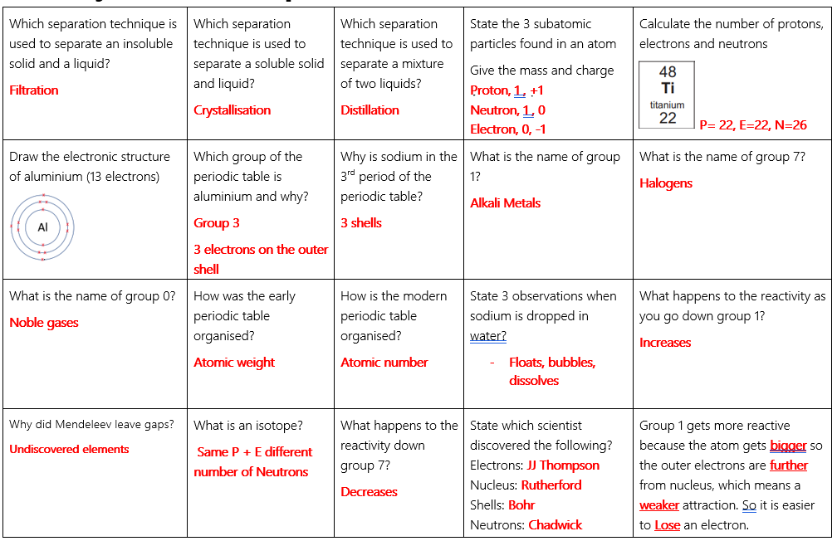
C1 – Atomic structure

Slide 3
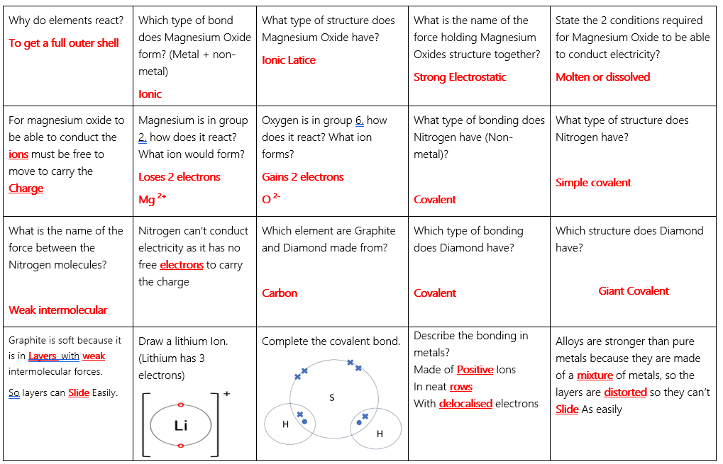
C2 – Bonding

Slide 4
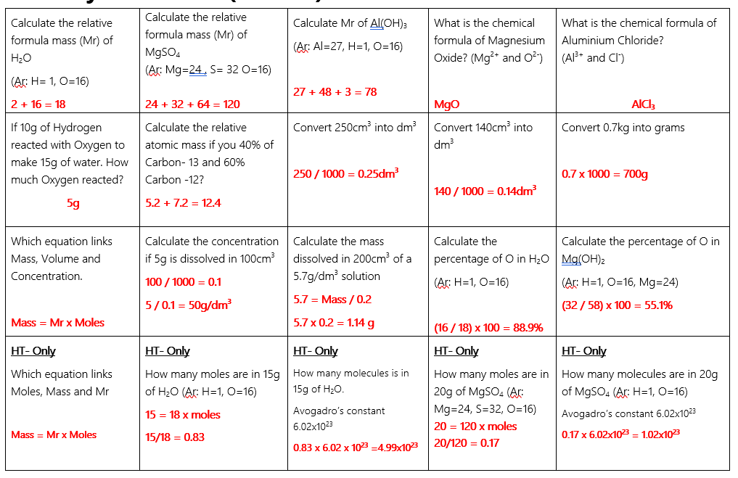
C3 – Quantitative chemistry

Slide 5
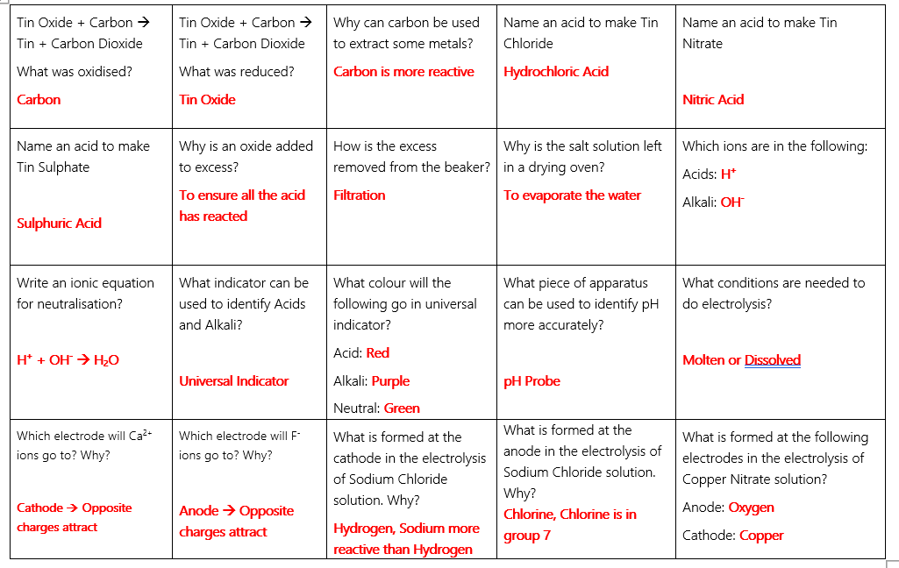
C4 – Chemical changes

Slide 6
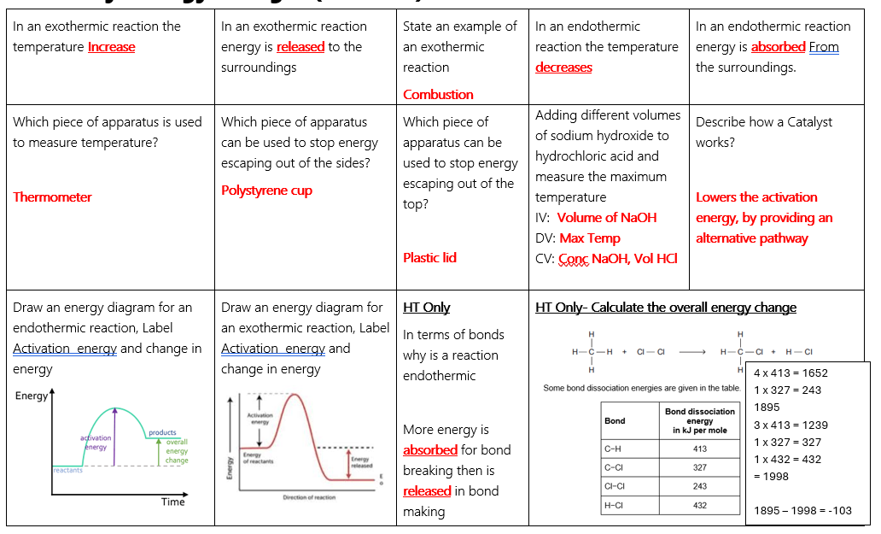
C5 – Energy changes

